Slide 1
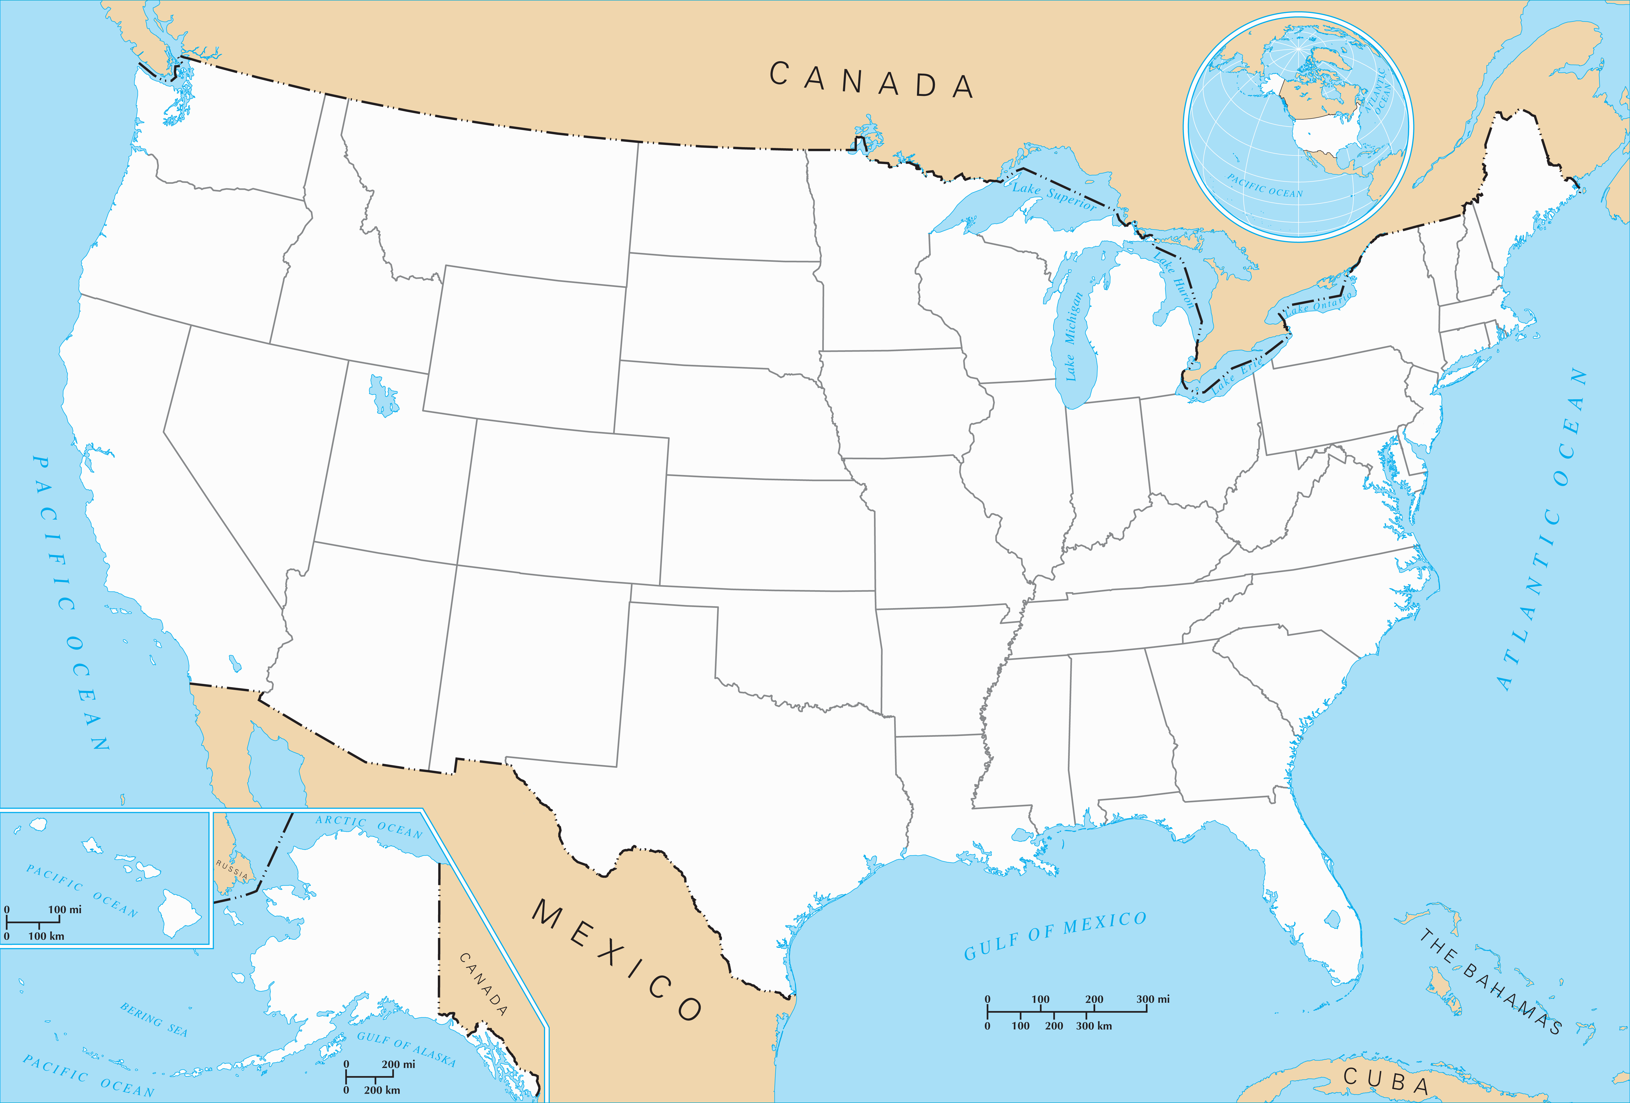
Safeco Field
1390
2070
680
300
430
Target Field
430
Rogers Centre
Fenway Park
465
Miller Park
210
225
195
80
Yankee Stadium
50
90
315
80
1500
240
Comerica Park
115
50
Citi Field
Wrigley Field
90
Oracle Park
Progressive Field
PNC Park
Citizens Bank Park
50
Guaranteed Rate Field
250
225
260
195
415
Oriole Park at Camden Yards
Oakland–Alameda County Coliseum
Coors Field
560
50
325
235
310
340
Great American Ball Park
300
Kauffman Stadium
Busch Stadium
Nationals Park
830
Las Vegas Stadium
Dodger Stadium
50
650
580
650
560
Angel Stadium of Anaheim
110
460
375
930
250
1255
Petco Park
300
680
Chase Field
870
740
Sun Trust Park
790
Globe Life Park in Arlington
1115
230
600
Minute Maid Park
790
Tropicana Field
210
Stadium locations are optimized for edge clarity.
Stadium locations are not accurate, but approximate.
965
Marlins Park
Drawn by Xavier Lian
CS1D Spring 2016

